Slide 1
Lecture 4
Input, Output, and String Formatting

Slide 2
Learning Outcomes:
- Gain a deeper understanding of user input and output in Python.
- Learn advanced string formatting techniques. - Build a basic Python program using multiple inputs and outputs.

Slide 3
1a. Correct Variable Naming in Python:
• Variable names must start with a letter or an underscore (_), but not a number.
• Variable names can only contain alphanumeric characters (A-Z, a-z, 0-9) and underscores (_).
• Variable names are case-sensitive (e.g., age and Age are different variables).
• Variable names should be descriptive and concise, avoiding abbreviations where clarity might be lost.
• Avoid using Python keywords like if, else, for, class, etc., as variable names.

Slide 4
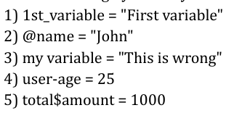

Slide 5

Basic Input and Output
Review the `input()` and `print()` functions for user interaction.
- Write a Python program that asks the user for their name and age, then displays the message using `print()`.

Slide 6

String Concatenation
Practice combining strings using concatenation.
- Write a Python program that accepts a favorite color and food from the user and combines them in a sentence.

Slide 7
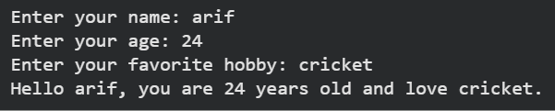
String Formatting Using f-Strings
Learn how to format strings using f-strings for cleaner code and output.
- Write a Python program that accepts name, age, and hobby, and formats them in a message using f-strings.

Slide 8
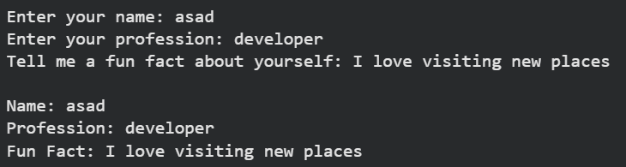
Advanced Input and Output
Learn to take multiple inputs and format them in a structured output.
- Write a program that asks for the user's name, profession, and a fun fact, then prints them in a multi-line format.

Slide 9

String Formatting with the `format()` Method
Learn how to use the `format()` method for string formatting.
- Write a program that asks for the user's favorite movie and city, then prints a formatted message using `format()`.

Slide 10

Handling Different Data Types in Input
Learn to handle different data types (integers, floats, strings) when accepting input.
- Write a program that asks for a person's height (float) and weight (float) and calculates their Body Mass Index (BMI).

Slide 11
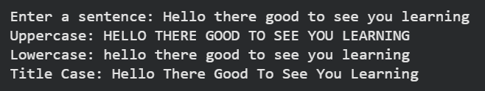
String Methods
Explore string methods like `upper()`, `lower()`, and `title()` to manipulate input.
- Write a program that takes a sentence from the user and prints it in uppercase, lowercase, and title case.

Slide 12
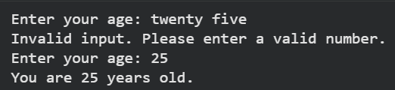
Input Validation and Error Handling
Implement input validation and error handling in Python to prevent invalid inputs.
- Write a program that asks for a user's age and ensures that the input is a valid integer. If it's not, display an error message and ask for the input again.

Slide 13
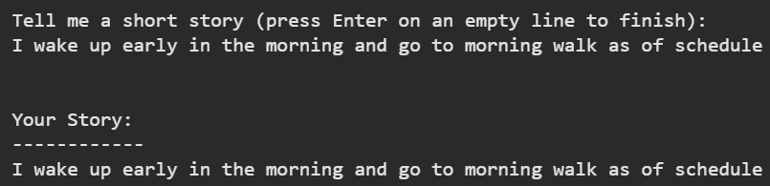
Multi-line Input and Output
Learn how to handle multi-line input and output.
- Write a Python program that accepts multiple lines of text from the user (e.g., a short story) and prints it back in a formatted structure.

Slide 14
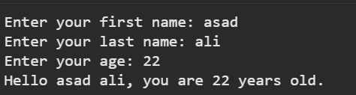
Combining Input from Multiple Sources
Practice accepting input from multiple sources and combining it into one output.
- Write a program that asks for the user's first name, last name, and age, and combines the inputs into a structured message.

Slide 15

Handling Special Characters in Input
Learn how to handle special characters in user input (such as quotes, slashes, etc.).
- Write a program that asks for a quote from the user and prints it, ensuring proper formatting of special characters.

Slide 16
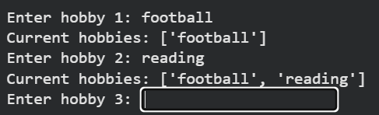
Looping Through User Input
Practice using loops to iterate through user input.
- Write a Python program that asks the user to enter five hobbies, stores them in a list, and prints the list after each input.

